Slide 1
Unit 1: Learning Target 1.2
Converting measurement within the metric system & Converting between scientific notation and standard notation

Slide 2
The Metric (SI) System of Measurement (note: the modern name for the metric system is the “SI” system.)
The Metric system is a decimal measuring system based on the meter, liter, and gram as units of length, volume, and mass. The system was first proposed by the French astronomer and mathematician Gabriel Mouton (1618–94) in 1670 and was standardized in France under the Republican government in the 1790s.
Because the metric system is a decimal system of weights and measures it is easy to convert between units (e.g. from millimeters to meters, or grams to kilograms) simply by multiplying or dividing by 10, 100, 1000, etc. Often this is just a case of moving the decimal point to the right or left. Fractional notation is not used, thus making any mental arithmetic very easy.

Slide 3
Conversions Within The Metric System
To convert among units in the metric system, identify the unit that you have, the unit that you want to convert to, and then count the number of units between them. If you are going from a larger unit to a smaller unit, you multiply by 10 successively. If you are going from a smaller unit to a larger unit, you divide by 10 successively. The factor label method can also be applied to conversions within the metric system. To use the factor label method, you multiply the original measurement by unit fractions; this allows you to represent the original measurement in a different measurement unit.
Visit the following websites for assistance:
https://tinyurl.com/yd62xbd2
https://tinyurl.com/q5bdw8n

Slide 6
Scientific Notation
Scientific notation is a way of writing very large or very small numbers. A number is written in scientific notation when a number between 1 and 10 is multiplied by a power of 10 with the exponent keeping track of the decimal place
For example, the mass of Earth maybe written in……
Standard Notation: 5,973,600,000,000,000,000,000,000.0 Kg
Scientific Notation: 5.972 ×10²⁴ Kg
For example, the mass of an electron maybe written in…….
Standard notation: 0.0000000000000000000000000000009109382 Kg.
Scientific Notation: 9.109 ×10⁻³¹ Kg.

Slide 7
Converting Scientific Notation to Standard Notation
To change a number from scientific notation to standard form, move the decimal point according to the value of the exponent. If the exponent is negative move the decimal to the left. If the exponent is positive move the decimal to the right.
See the following slide for an example.

Slide 9
Converting Standard Notation to Scientific Notation
A number written in standard notation can be converted to scientific notation by increasing the exponent by one for each place the decimal point is moved.
There are four steps involved here:
Step 1 – move the decimal such that your number is between 1 and 10.
Re-write your number (which is now between 1 and 10) and add the “×10” symbol.
Count the number of times you moved your decimal, this is your exponent.
Determine if the exponent should be positive or negative.
See the next 2 slide for an example.

Slide 10
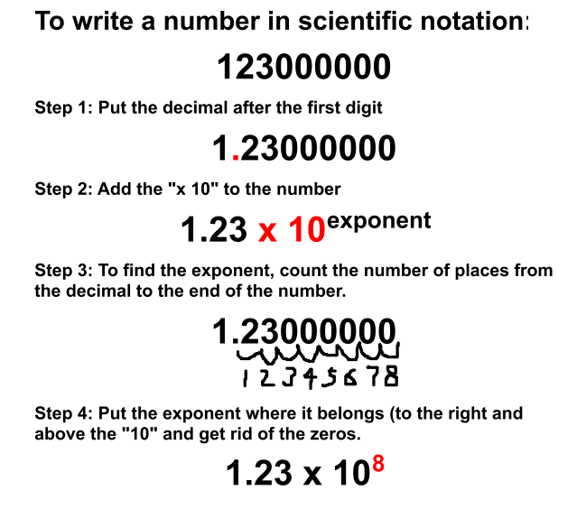

Slide 12
Visit the following websites for tutorials on scientific notation:
https://tinyurl.com/ycst2sy7
https://tinyurl.com/y9hgxfuk

