Slide 1
Unit 1: Learning Target 1.5
Create & Interpret Motion Graphs:
Position (distance) vs. Time Graphs
Velocity (speed) vs. Time Graphs

Slide 2
Motion Graphs
Two different “motion graphs” are important.
Distance vs. Time Graphs (also called Position vs. Time Graphs)
Speed vs. Time Graphs (also called Velocity vs. Time Graphs)

Slide 3
Position vs. Time Graphs (also called Distance vs. time graphs)
Time is on the X-axis as the independent variable.
Position (or distance) is on the Y-axis as the dependent variable.
The slope of any graph is Rise/Run or Change in X / Change in Y.
The slope of a Position vs. Time Graph is the velocity of the object.
Visit the following website for help on Position-Time Graphs: https://www.youtube.com/watch?v=4J-mUek-zGw

Slide 4
Position Vs. Time Graphs (also called distance vs. time graphs)
A straight line indicates constant speed.
A horizontal line indicates no motion, or zero speed.
A positively sloped line indicates motion away from the reference point or positive velocity.
A negatively sloped line indicates motion toward the reference point, or negative velocity.
A steeper slope indicates a faster speed.
The value of the slope is speed defined with units of distance over time.
A curved line of changing slope indicates linear acceleration, or a change in speed.
The rate of curvature defines the amount of acceleration.

Slide 5
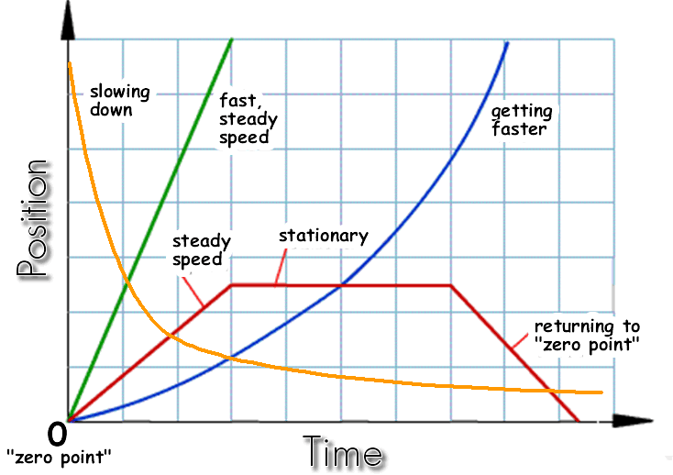
Position vs. Time Graphs

Slide 6
Velocity vs. Time Graphs (also called Speed vs. Time Graphs)
Time is on the X-axis as the independent variable.
Velocity (or speed) is on the Y-axis as the dependent variable.
The slope of any graph is Rise/Run or Change in X / Change in Y.
The slope of a Velocity vs. Time Graph is the acceleration of the object.
Visit the following website for help with Velocity-Time Graphs: https://www.youtube.com/watch?v=lTE83sP7lQg

Slide 7
Velocity vs. Time Graphs (also called Speed vs. Time Graphs)
A straight line indicates the object has velocity.
A horizontal line indicates constant velocity, or zero acceleration.
A positively sloped line indicates increasing velocity.
A negatively sloped line decreasing velocity
A steeper slope indicates a higher rate of change.
The value of the slope is speed defined with units of velocity over time.
A curved line of changing slope indicates increasing/decreasing acceleration, or a changing rate of acceleration.
The rate of curvature defines how fast the velocity is changing.

Slide 8
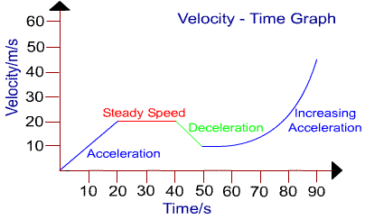
Velocity vs. time graphs

