Slide 1
Unit 2 - Forces
Learning Target 2.3 – Describe the relationship between Force, mass, & acceleration (newton’s 2nd law)

Slide 2
Newton’s Second Law (Force = Mass × Acceleration)
Background vocabulary:
Force – any action that has the ability to change motion.
Mass – a measure of the amount of matter (atoms/molecules) in any given object.
Acceleration – any change in motion (speed up, slow down, change direction)
These three terms are related. That means that if you change one the others will also change.
Your goal is to describe these changes. For example if mass gets bigger what happens to acceleration? IF force gets bigger what happens to acceleration?

Slide 3
Newton’s Second Law (Equation version)
Three versions of the equation:
Force (N) = Mass (kg) × Acceleration (m/sec²)
Short version: F = MA
Mass (kg) = Force (N) ÷ Acceleration (m/sec²)
SHORt VERSION: m = f/A
Acceleration (m/sec²) = Force (N) ÷ Mass (kg)
Short version: A = f/m

Slide 4
Newton’s second law (What the equation means)
Newton’s second law describes the relationship between force, mass, & acceleration. (three sentences are necessary in this description)
Force causes acceleration (forces make things change their motion)
Mass resists acceleration (objects try to resist forces making them change motion)
Acceleration (change in motion) is determined by the ratio of force over mass.
This means that any change in motion is a battle between forces (trying to cause motion) and Masses (trying to resist change in motion)
The force & the mass are both needed to describe a change in motion (acceleration)

Slide 6
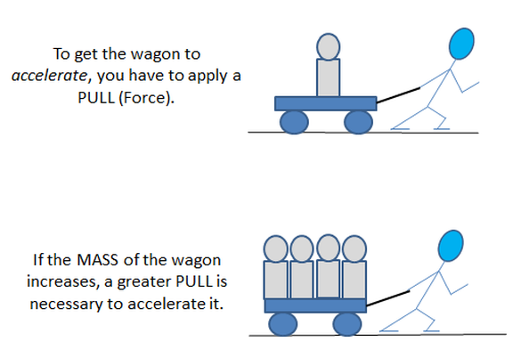

Slide 7
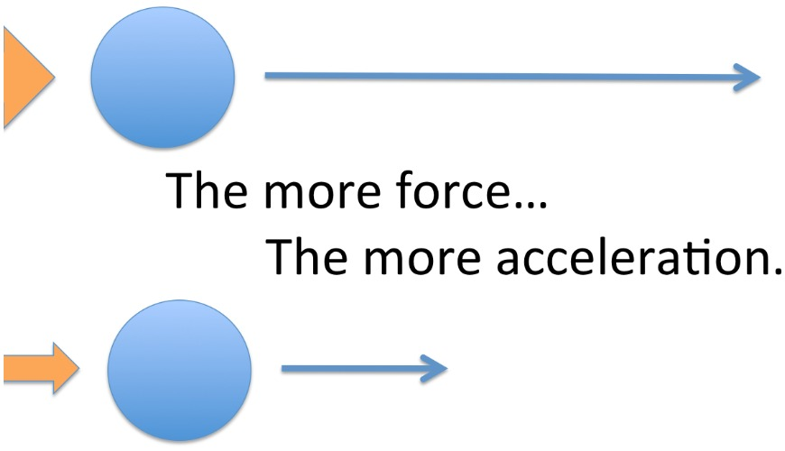

Slide 8
