Slide 1
Unit 2 – Forces
Learning Target 2.4 – Explain the difference between mass & weight

Slide 2
Mass vs. Weight
Mass & Weight are closely connected however they are not the same thing.
Mass is a measure of the amount of matter (think atoms) present in any given object.
Think about your computer, it contains some number of atoms. That is your computer’s mass.
Weight is a measure of the force (push/pull) that is acting on an object’s mass.
Earth’s gravity is pulling down on your computer with some amount of force (strength). That is your computer’s weight.

Slide 3
Mass (characteristcs of)
Mass is how much matter an object contains.
Mass is measured with a balance.
The SI unit of mass is the kilogram (kg).
Mass does not changed based on location.

Slide 4
Weight (characteristics of)
Weight is a measure of the force acting on an object (this force is often gravity but does not have to be, any push or pull can produce a weight force)
Measured with a scale (in units of Newton’s for the metric system and Pounds (lbs.) in the English system)
Weight does change base on location (this is due to gravity being stronger/weaker based on where you are, for example your weight on the moon is less than on Earth because the moon cannot “pull” as hard on you)

Slide 5
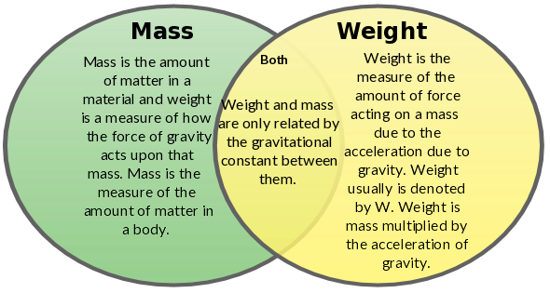

Slide 7
