Slide 1
Unit 2 - Forces
Learning Target 2.6 –
Describe & Apply Newton’s 3rd Law of Motion (Force-Pairs)

Slide 2
Newton’s 3rd Law of Motion: Force Pairs
The 3rd Law of Motion states:
For every action force there is a reaction force equal in magnitude and opposite in direction.
The term force-pairs refers to the action & reaction forces.
It is important to note the following:
If an action force is generated a reaction force is created simultaneously.
The forces are exactly equal in magnitude (equal in strength or size)
The direction of the forces are exactly opposite.
The forces do not cancel because they are acting on two different objects and thus can not cancel each other.
Note: if the forces were acting on a single object they could cancel (see learning target 2.2 for further discussion on balanced vs. unbalanced forces)

Slide 3
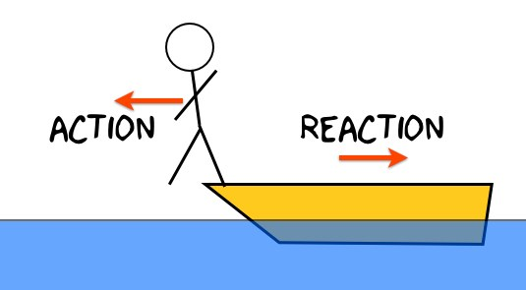

Slide 5
