Slide 1
Unit 3 - Energy
Learning Target 3.2 – Be able to use the equations for Potential Energy & Kinetic Energy

Slide 2
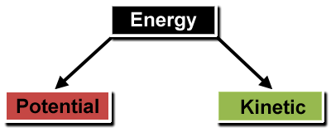

Slide 3
Potential Energy
Potential energy is a form of energy that results from an object's position or arrangement of parts. It is stored energy that can become kinetic energy.
The measurement of potential energy in an object is calculated based on the object's mass and its height or distance.
It is measured in Joules.

Slide 5
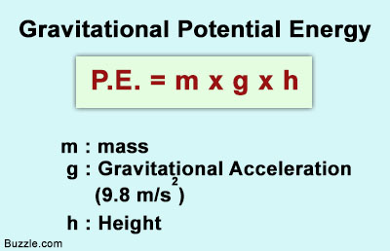
Potential Energy Calculations
Note: for Potential energy calculations we will focus on “Gravitational Potential Energy”

Slide 6
Kinetic Energy
Kinetic energy is a form of energy that results from an object's motion.
There are many types of motion that use kinetic energy: translation (moving from one place to another), rotation, and vibration.
The measurement of kinetic energy in an object is calculated based on the object's mass and velocity.
It is measured in Joules.

Slide 8
Kinetic Energy Calculations

Slide 9
