Slide 1
Unit 3 - Energy
Learning Target 3.4 – Define Temperature and explain how thermal energy is transferred (conduction, convection, & radiation)

Slide 2
Temperature
Temperature is a measure of the average kinetic energy of the particles in an object.
Temperature Depends on the Kinetic Energy of Particles All matter is made of particles - atoms or molecules - that are in constant motion. Because the particles are in motion, they have kinetic energy. The faster the particles are moving, the more kinetic energy they have and the hotter they are.

Slide 3
The Kinetic Theory of Matter

Slide 4
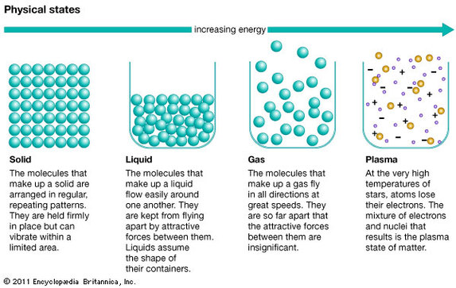

Slide 5
Thermal Energy Transfer (Heat transfer)
Heat can be transferred from one place to another by three methods: conduction in solids, convection of fluids (liquids or gases), and radiation.
If there is a temperature difference in a system, heat will always move from higher to lower temperatures.

Slide 6
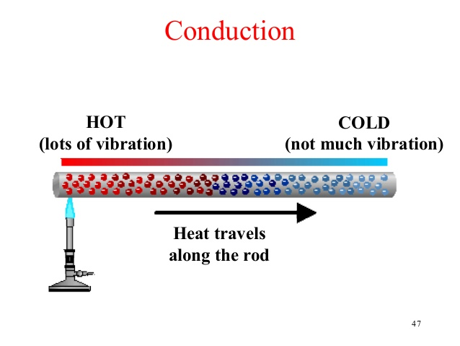
In conduction, energy is transferred from particle to particle by direct contact; the particles themselves do not necessarily change position, but simply vibrate more or less quickly as kinetic energy is transferred. The thermal energy always moves from cold-to-hot.

Slide 7
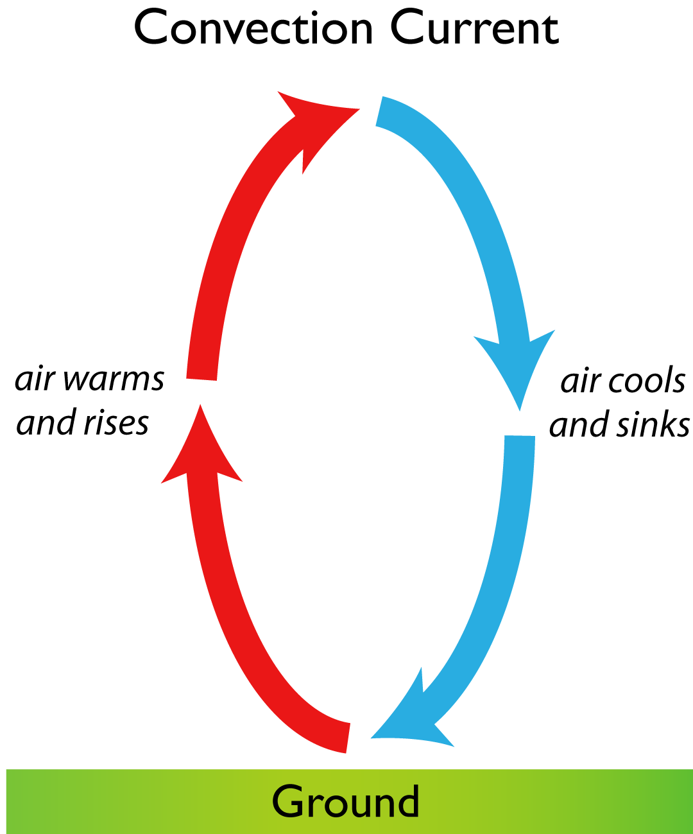
Convection - movement in a gas or liquid in which the warmer parts move up and the cooler parts move down transferring thermal energy.

Slide 8
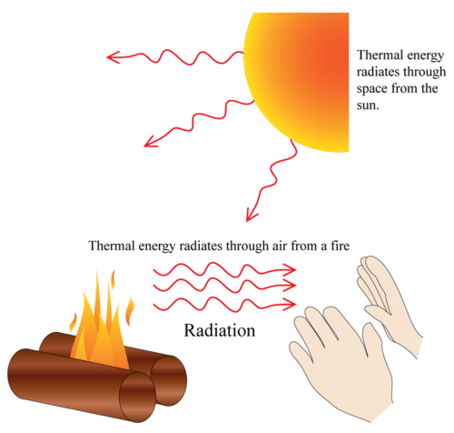
Radiation – The transfer of thermal energy via an electromagnetic wave (light)

Slide 9
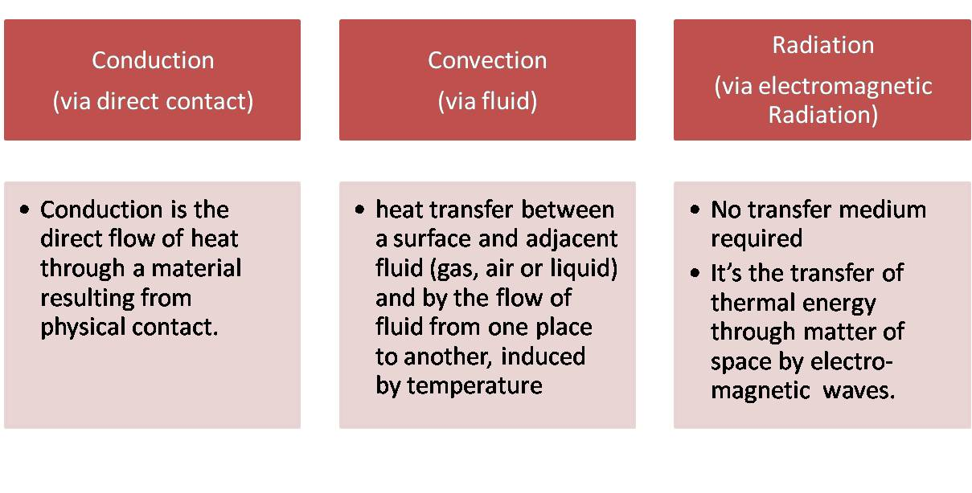

Slide 10
