Slide 1
Unit 3 - Energy
Learning Target 3.5 – Be able to describe scientific Work & Power

Slide 2
Work (measured in Joules)
In physics, work is defined as a force causing the movement—or displacement—of an object.
The scientific definition of work reveals its relationship to energy—whenever work is done, energy is transferred.
For work, in the scientific sense, to be done, a force must be exerted and there must be Displacement (movement) in the direction of the force.
Work can be though of as the amount of energy needed to move an object some distance.

Slide 4
Power (measured in Watts)
Power is the rate at which work is done.
In other words, power is the rate at which energy is used/transmitted.

Slide 5
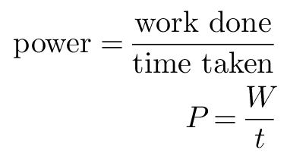

Slide 6
