Slide 1
Unit 4 – Energy
Learning target 4.3 – Define and relate wavelength, frequency, amplitude, period, and wave speed.

Slide 2
Wave properties & Characteristics
Wavelength
Frequency
Amplitude
Period
Wave speed

Slide 3
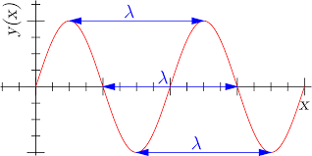
Wavelength (λ)
The wavelength of a wave is defined as the distance between two crests on a wave.
The symbol for wavelength is the Greek letter Lambda which is depicted as follows: λ
Note: the wavelength is often measured from “crest-to-crest” however one does not have to use the crest. To measure wavelength one can choose any spot on a wave and measure to that same place on the next wave.

Slide 4
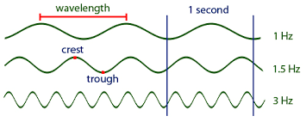
Frequency (f)
The frequency of a wave is defined as the number of waves that pass a fixed point in a given amount of time (usually 1 second).
Frequency is measured in a unit called Hertz (Hz).
Another way to think about frequency is to ask how often the wave oscillates (up/down or left/right)
Frequency is the number of waves per second.

Slide 5
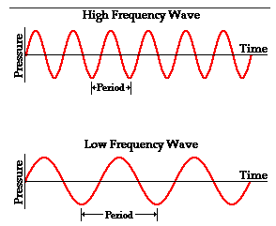
Frequency (continued)….

Slide 6
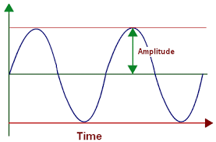
Amplitude
The amplitude of a wave is defined as the maximum distance away from equilibrium.
In other words amplitude is how far away the wave gets from its center.

Slide 7
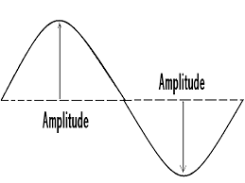
Amplitude (continued)….

Slide 8
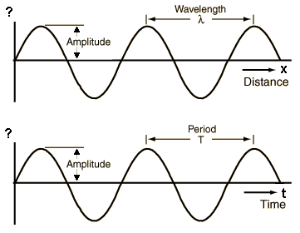
Period (T)
The period of a wave is defined as the time it takes to complete one full cycle of a wave.
The period of a wave can be calculated as 1/frequency.

Slide 9
Wave Speed (or wave velocity)
Wave speed refers to how fast a wave is traveling. It is calculated with the following equation: V = f × λ or velocity = frequency × wavelength

