Slide 1
Unit 4 - Energy
Learning Target 4.4 – Be able to describe wave interactions (reflection, refraction, diffraction, and absorption),

Slide 2
Wave interactions
A wave can interact with an object in one of four ways:
Reflection
Refraction
Diffraction
Absorption

Slide 3
Reflection
Reflection occurs when a wave contacts an object and bounces off in a new direction.
Alternatively: Reflection is a change in the direction of a wave upon striking the interface between two materials.
The Law of Reflection states: that the incident ray, the reflected ray, and the normal to the surface of the mirror all lie in the same plane. Furthermore, the angle of reflection is equal to the angle of incidence. Both angles are measured with respect to the normal to the mirror.

Slide 5
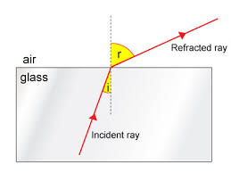
Refraction
Refraction It’s the change in direction of a wave due to a change in its medium.
Alternatively: Refraction is the change in direction of propagation of a wave when the wave passes from one medium into another, and changes its speed.
Refraction is essentially a surface phenomenon.

Slide 6
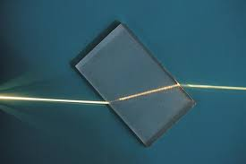
Refraction (an example)
Notice the laserbeam changes its direction as it enters the glass (crossing the air/glass interface) and as it exits the glass (again crossing the air/glass interface).

Slide 7
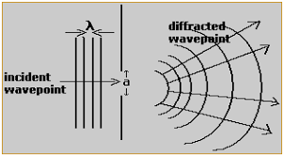
Diffraction
Diffraction occurs when a wave changes direction as it passes through an opening or around a barrier in its path.
Alternatively: the spreading-out of waves around obstacles.

Slide 8
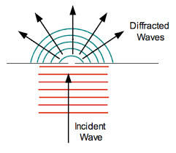
Diffraction (Example)

Slide 9
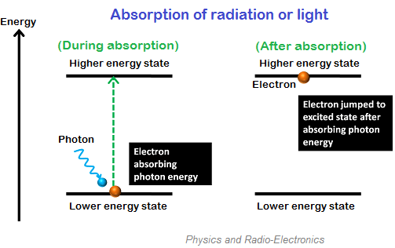
Absorption
Absorption is the transfer of the energy of a wave to matter as the wave passes through it.
The following is an example of how light energy is absorbed by matter (atoms/molecules)

