Slide 1
Unit 4 - Energy
Learning Target 4.5 – Understand & describe wave interference (constructive & destructive).

Slide 2
Wave Interference
Wave interference occurs when two (or more) waves meet and interact with one another.
There are two types of wave interference:
Constructive Interference
Destructive Interference

Slide 3
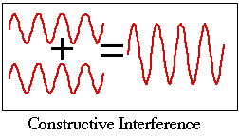
Constructive Interference
Constructive interference occurs whenever waves come together to create a wave of larger amplitude.
This means that their oscillations at a given point are in the same direction, the resulting amplitude at that point being much larger than the amplitude of an individual wave

Slide 4
Constructive Interference Example

Slide 5
Destructive Interference
Destructive Interference occurs when two (or more) waves interact to create a wave of lower amplitude.
Often the amplitude of the new wave is zero.

Slide 6
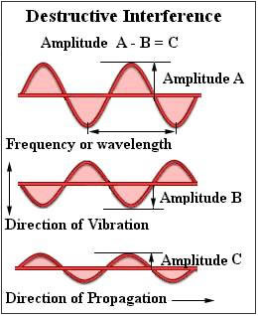
Destructive Interference Example

Slide 7
