Slide 1
Unit 1 –Atomic Structure
Learning Target 1.2 – Identify and describe isotopes using mass number, atomic number, and isotope notation

Slide 2
Isotopes
Isotopes – atoms that have the same number of protons but a different number of neutrons.
Mass Number – is the total number of Protons + Neutrons
Atomic Number – is the number of Protons only
To determine the number of Neutrons for a given isotope use the following equation
Mass Number – Atomic Number = Number of Neutrons

Slide 3
Isotope Notation
Isotope notation is a symbol that provides the atomic structure of any given isotope.
The symbol includes the following information:
Mass Number (upper left-hand corner)
Atomic Number (lower left-hand corner)
Charge (upper right-hand corner)
Note: many isotopes do not have a charge so there may be no information in the upper right-hand corner)

Slide 4
Two ways to write isotope notation
Symbol Form & Written Form
Note: the written form “C-14” can also be written as Carbon-14

Slide 5
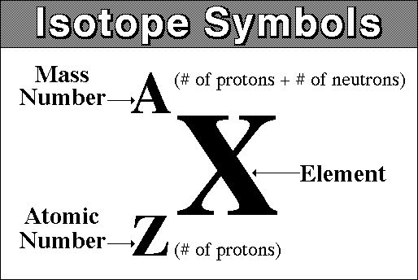

Slide 6
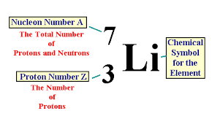

Slide 7
