Slide 1
Unit 1 – Atomic Structure
Learning Target 1.3 – Identify ions and be able to determine their charge.

Slide 2
Ions
Ions are atoms that have gained or lost electrons.
The gaining or losing of electrons is referred to as the process of ionization (becoming an ion)
Atoms start with equal numbers of positive-protons and negative-electrons giving the atom an overall charge of zero or neutral.
Atoms become ions by gaining or losing electrons.

Slide 3
Ions
If an atom gains electron(s) it becomes a negative ion.
Negative ions are called Anions.
If an atom loses electron(s) it becomes a positive ion.
Positive ions are called Cations.

Slide 4
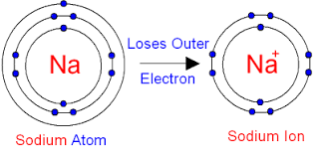
Becoming a Positive Ion (Cation) By Losing An Electron

Slide 5
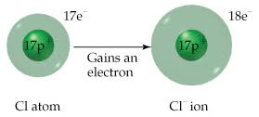
Becoming a Negative Ion (Cation) By Gaining An Electron

