Slide 1
Unit 2 – Chemical Bonding
Learning Target 2.2 – Identify an describe covalent bonding & Ionic bonding.

Slide 2
Ionic Bonding
Ionic bonding is the transfer of electron(s) from a metal atom to a non-metal atom.
To determine if a bond is ionic or not one has to determine the types of atoms involved (metal or non-metal).
If there is at least one metal and a least one non-metal the bond can be called Ionic.
The position of the element on the periodic table indicates if it is a non-metal or a metal.
Non-metal atoms are found on the right-side of the periodic table.
Metal atoms are found on the left-hand side and the middle of the periodic table.
A diagonal line from Boron to Astatine separates metals from non-metals.

Slide 3
Covalent bonding
Covalent bonding is the sharing of electron(s) between two, or more, non-metal atoms.
To determine if a bond is covalent or not one has to determine the types of atoms involved (metal or non-metal).
If there is at least two non-metal atoms the bond can be called covalent.
The position of the element on the periodic table indicates if it is a non-metal or a metal.
Non-metal atoms are found on the right-side of the periodic table.
Metal atoms are found on the left-hand side and the middle of the periodic table.
A diagonal line from Boron to Astatine (metalloids) separates metal from non-metal.

Slide 4
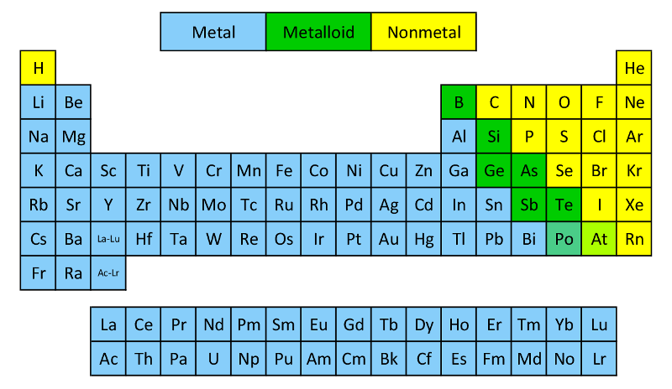

Slide 5
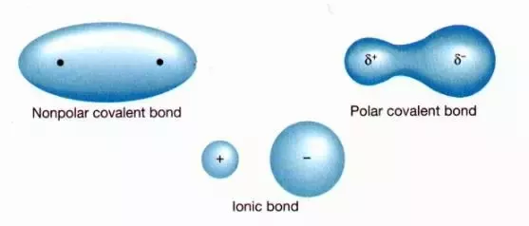
Polar vs. Non-polar covalent bonds
Covalent Bonds are bonds in which electrons are shared between two or more non-metal atoms.
If the atoms are sharing electrons equally it is called a non-polar covalent bond.
If the atoms are sharing electrons unequally it is called a polar covalent bond.

