Slide 1
Unit 2 – Chemical Bonding
Learning Target 2.4 – Write and name chemical formulas for ionic and covalent compounds.

Slide 2
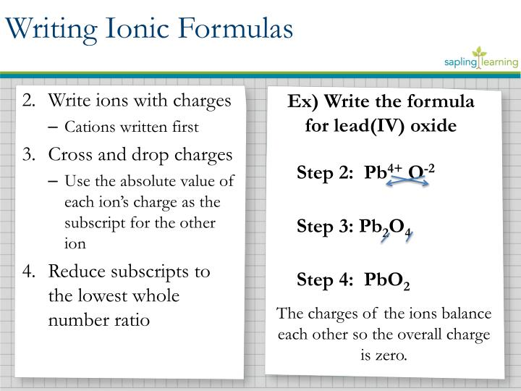
Writing Formulas for Ionic Compounds.

Slide 3
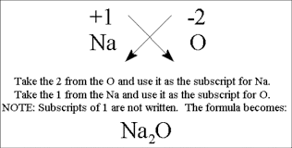
Another Example of Writing Ionic Formulas: write the positive ion formula and the negative ion formula then….

Slide 4
Naming Ionic Formulas
Step 1 – write the name of the positive ion.
Step 2 – write the root word of the negative ion.
Step 3 – add the suffix –ide to the root word of the negative ion.
  Example: if Calcium (cation) and Chlorine (anion) for a molecule we name it…
    Calcium Chloride
  Example: if Lithium (cation) and Fluorine (anion) form a molecule we name it..
    Lithium Fluoride

Slide 5
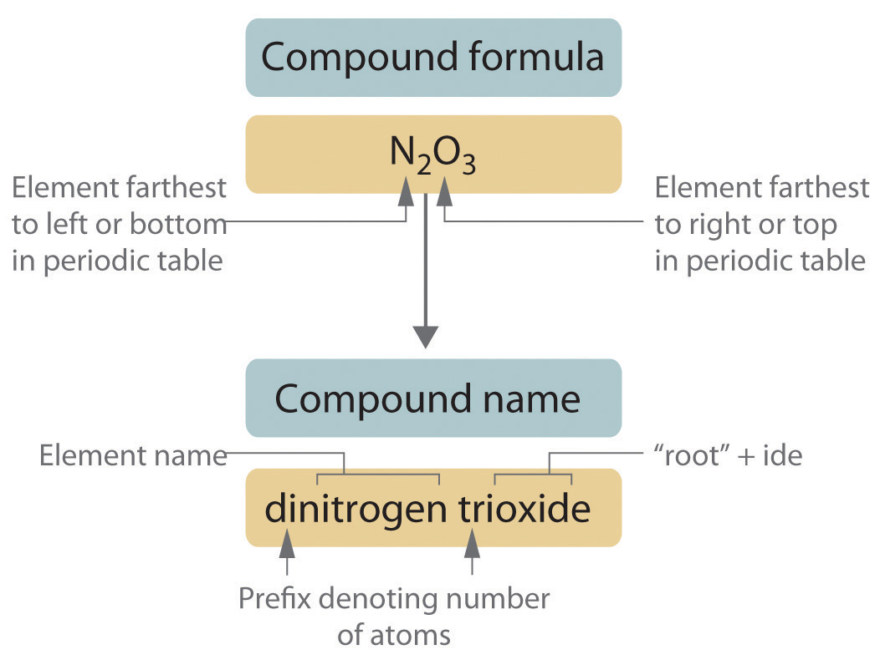
Writing & Naming Formulas for Covalent Compounds

Slide 6
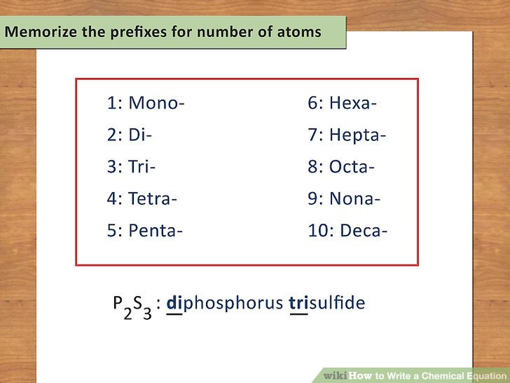
Prefixes for Naming Covalent Compounds

