Slide 1
Unit 3 – Chemical Reactions
Learning target 3.1 – Identify Physical vs. chemical changes

Slide 2
Physical changes
Physical changes are changes affecting the form of a chemical substance, but not its chemical composition.
In other words: if the chemical structure of a substance does not change we call it “physical”.
In a physical change no new substance is created.

Slide 4
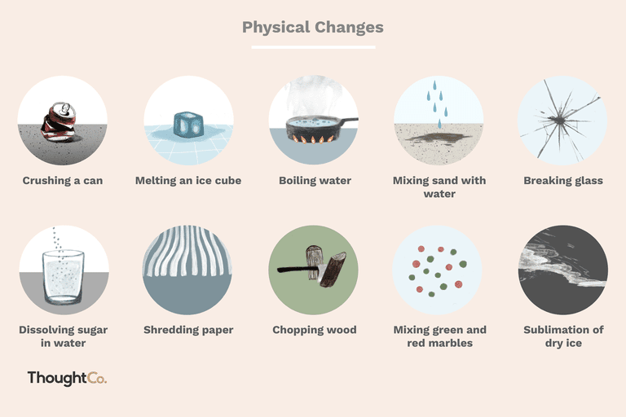

Slide 5
Chemical changes
A chemical change occurs when the substance's composition is changed.
When bonds are broken and new ones are formed a chemical change occurs.
When a new chemical is created the process is called a chemical change.

Slide 6
