Slide 1
Unit 3 – Chemical Reactions
Learning Target 3.3 – Describe six methods/options for controlling the rate of a chemical reaction.

Slide 2
Reaction Rate
Reaction rate refers to the amount of time it takes for a chemical reaction to be complete.
There are five ways to control reaction rate.
Concentration
Surface Area
Temperature
Catalyst
Inhibitor

Slide 3
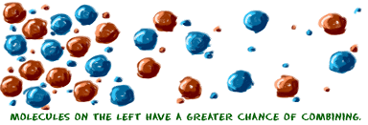
Concentration
In chemistry, concentration refers to the amount of a substance per defined space. The more concentration the more chemical present.
If concentration goes up, reaction rate goes up.
If concentration goes down, reaction rate goes down.
Notice in the image below there are more particles on the left (high concentration) than the right (low concentration)

Slide 4
Surface Area
Surface area is the measure of how much exposed area a solid object has. In other words, how much of a substance is accessible from the outside.
If surface area goes up, reaction rate goes up.
If surface area goes down, reaction rate goes down.

Slide 6
Temperature
Temperature is the average kinetic energy (motion) of the particles making up a substance.
As temperature goes up (more particle motion) reaction rate goes up.
As temperature goes down (less particle motion) reaction rate goes down.

Slide 8
Catalysts & Inhibitors
Catalyst
Any chemical that speeds up a reaction.
Inhibitor
Any chemical that slows down a reaction.

