Slide 1
Unit 3 – Chemical Reactions
Learning Target 3.4 – Identify/Classify various types of chemical reactions. (single-replacement, double-replacement, decomposition, synthesis/addition, combustion, exothermic, endothermic)

Slide 2
Exothermic Reactions
An exothermic reaction releases energy.
Energy will appear as a product in the equation.

Slide 3
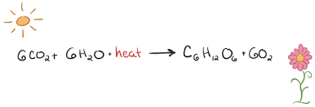
Endothermic reactions
Endothermic reactions consume energy.
Energy will appear as a reactant in the chemical equation.

Slide 4
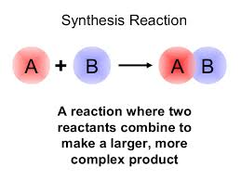
Synthesis (addition) reaction
A synthesis (or addition) reaction is a reaction in which two reactants combine to form one larger/more complex product.

Slide 5
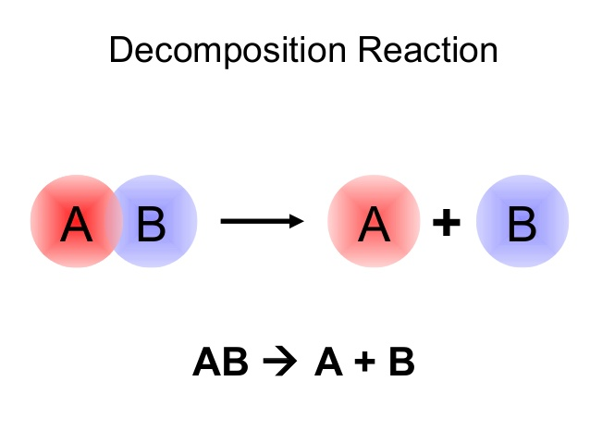
Decomposition reaction
A decomposition reaction is one in which a single reactant is broken down into more than one product.

Slide 6
Single Replacement Reaction
A single-replacement (also called single-displacement) reaction is one in which one atom takes the place of another within a molecule.

Slide 7
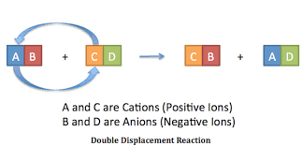
Double replacement reaction
A double replacement reaction (also called double displacement) is a reaction in which two pairs (of atoms) switch partners.

Slide 8
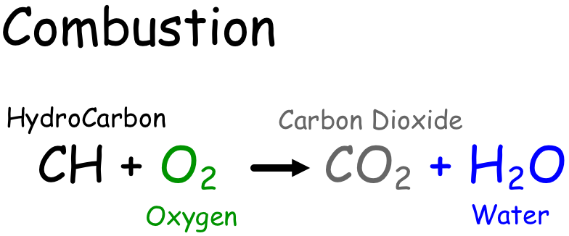
Combustion reactions
A combustion reaction is one in which a carbon-containing compound is combined with oxygen to produce carbon dioxide, water, and energy.

