Slide 1
Unit 4 – Nuclear Reactions
Learning Target 4.1 – Identify and describe nuclear reactions: Fission & Fusion

Slide 2
Nuclear Reactions
a change in the identity or characteristics of an atomic nucleus.

Slide 3
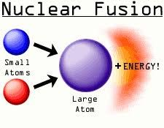
Fusion
Combining two, or more, atomic nuclei to create a larger atomic nucleus.
This process releases/produces energy.

Slide 4
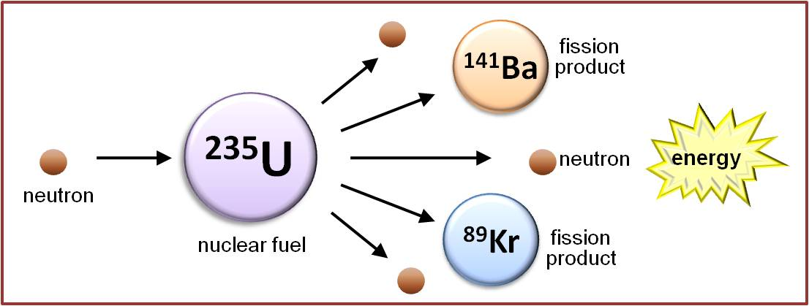
Fission
Fission is the process of splitting a large, unstable, nucleus into smaller, stable, nuclei.
This process releases a large amount of energy.

Slide 5
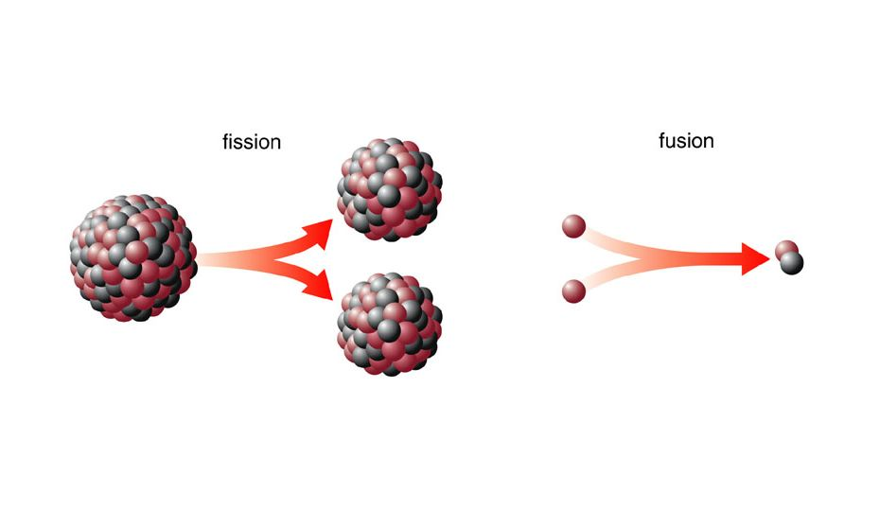

Slide 6
Radioactivity
Radioactivity is the emission of particles or energy from an unstable nucleus.
There are three main types of radioactivity
Alpha
Beta
Gamma

Slide 7
Alpha Radiation (decay)
During Alpha Decay
An unstable nucleus emits a particle consisting of 2-protons and 2-neutrons (essentially a helium nucleus)
This particle is called an “alpha” particle
Each time an alpha particle leaves a nucleus the nucleus gets smaller.
The atomic number is decreased by 2
The mass number is decreased by 4

Slide 8
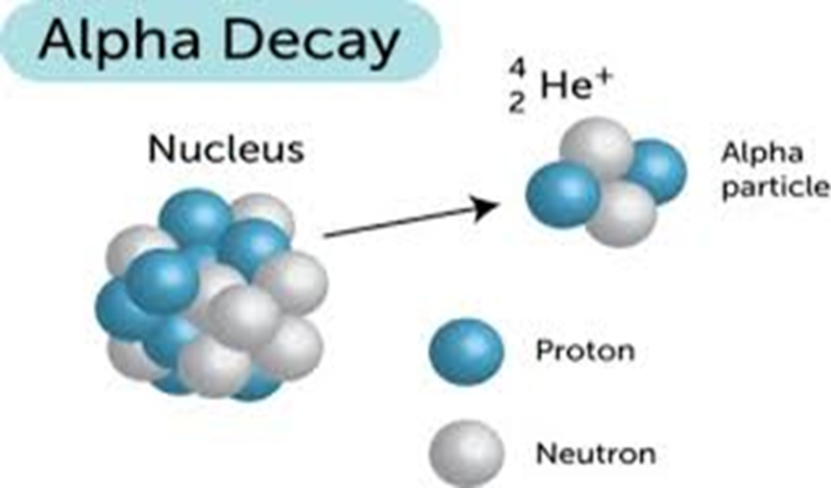

Slide 9
Beta Radiation (decay)
During beta decay.
A neutron turns into a proton and an electron (beta particle).
The proton stays in the nucleus.
The electron is emitted as a beta particle.

