Slide 1
Unit 4 – Nuclear Reactions
Learning Target 4.2 – Define Radioactivity and describe three forms: Alpha, Beta, & Gamma

Slide 2
Radioactivity
Radioactivity – the emission/release of energy and/or particles from an unstable nucleus.
Three main types:
Alpha Decay (Radiation)
Beta Decay (Radiation)
Gamma Decay (Radiation)

Slide 3
Alpha Decay (Radiation)
During the process of Alpha Decay (Radiation)
Energy is released in the form of an Alpha Particle
An alpha particle consist of 2-protons & 2-neutrons. (this is essentially a helium nucleus).
Alpha Particle Symbol - ⁴₂ He or
The release of an Alpha Particle causes the following changes to the nucleus:
Mass number reduced by 4
Atomic number reduced by 2

Slide 4
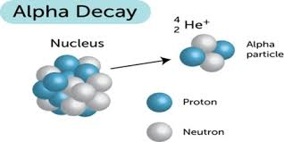

Slide 5
Beta Decay (Radiation)
During the process of Beta Decay:
A proton splits into a neutron and an electron.
The neutron stays in the nucleus.
The electron is emitted as a beta particle (an electron).
Symbol for Beta Particle - ⁰₋₁e
Beta decay causes the following changes in a nucleus
Atomic number goes up by one.
(note: the mass does not change)

Slide 6
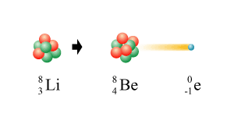
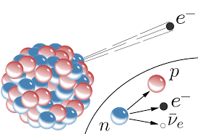

Slide 7
Gamma Decay (Radiation)
During the process of Gamma Decay (radiation)
An unstable nucleus emits electromagnetic radiation (light wave / photon) to become a stable nucleus.

Slide 8
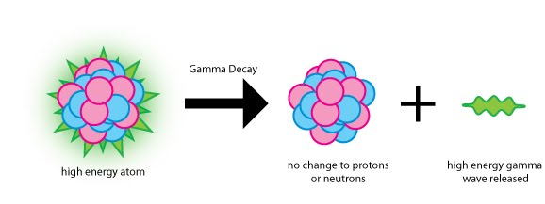
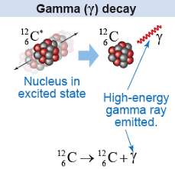

Slide 9
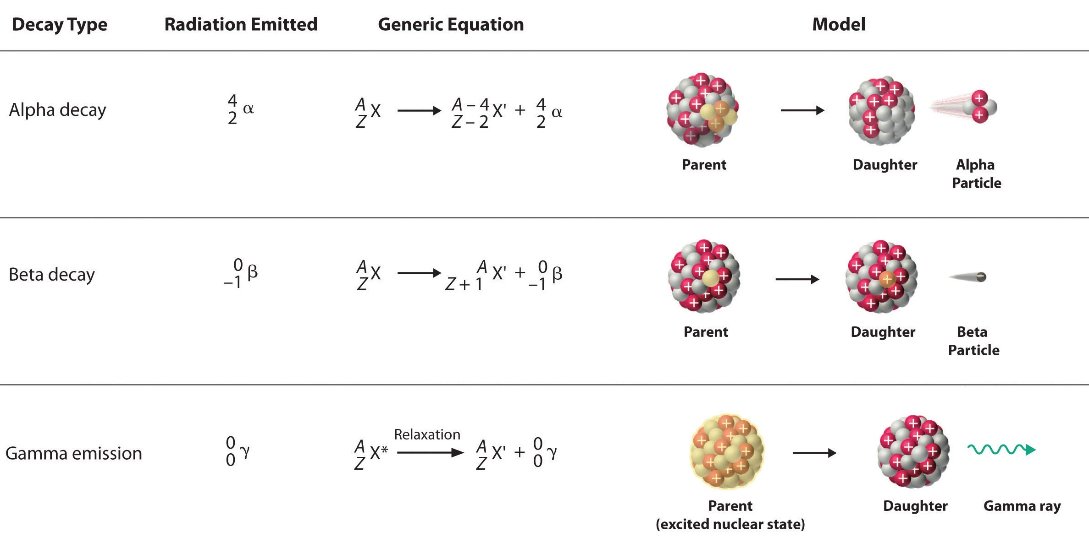

Slide 10
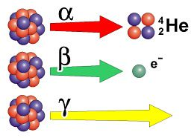

Slide 11
How to Block Radiation

