Slide 1
Unit 4 – nuclear reactions
Learning Target 4.4 – Read, write, and balance nuclear equations using isotope notation.

Slide 2
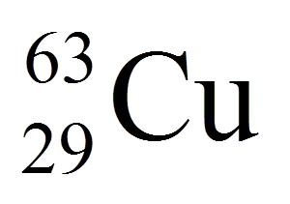
Isotope Notation

Slide 4
Reading a Nuclear Equation

